Slide 1

DEPARTMENT OF ELECTRONICS AND COMMUNICATION
Minor Project-II
Brain Signal Classification Using EEG And Machine Learning
Guided by:
Mr. Ankit Muley
Submitted by:
Saloni Parihar
Siddharth Pal

Slide 2
CONTENTS
Objective
Introduction
Literature Survey
Methodology
Results
Conclusion AND Future Scope
References

Slide 3
OBJECTIVE
The objective of this project is to classify EEG brain signals using machine learning by processing raw data, extracting relevant features, and identifying different brain activities to support Brain-Computer Interface (BCI) applications.

Slide 4
INTRODUCTION
Brain Signal Classification using EEG and Machine Learning is an advanced approach that enables the analysis and interpretation of brain activity through Electroencephalography (EEG) signals. By combining signal processing techniques with machine learning algorithms, the system can identify and classify different patterns of brain activity for various applications.
EEG signal acquisition and processing: EEG signals are collected using electrodes placed on the scalp and then pre-processed to remove noise and artifacts, ensuring reliable data for analysis.
Feature extraction and classification: meaningful features are extracted from the processed EEG signals and used to train machine learning models capable of distinguishing different brain activity patterns.
Brain-Computer Interface applications: accurate classification of EEG signals enables the development of BCI systems that allow communication and control through brain activity without physical movement.
Healthcare and assistive technology: EEG-based classification systems can support neurorehabilitation, medical diagnosis, assistive devices, and intelligent human-machine interaction.

Slide 5
Applications-:
• Brain-Computer Interfaces (BCI): Enables users to control computers, wheelchairs, robotic devices, and other systems using brain signals.
• Healthcare and Medical Diagnosis: Assists in the detection and monitoring of neurological disorders such as epilepsy, Alzheimer's disease, Parkinson's disease, and sleep disorders.
• Neurorehabilitation: Supports the recovery of patients with motor impairments by facilitating brain-controlled rehabilitation and therapy systems.
• Assistive Technology: Helps individuals with physical disabilities communicate and interact with external devices without requiring muscular movement.
• Mental State Monitoring: Used to analyze attention levels, stress, fatigue, emotions, and cognitive workload in real-time.
• Research and Neuroscience: Assists researchers in understanding brain functions, neural activity patterns, and human cognition.
• Gaming and Virtual Reality: Enhances user interaction by enabling brain-controlled gaming and immersive virtual reality experiences.

Slide 6
LITERATURE REVIEW
S. No. | Title | Year | Summary
1. | Evaluation of Machine Learning Algorithms for Classification of EEG Signals | 2022 | This paper reviews the use of machine learning algorithms in EEG-based Brain–Computer Interface (BCI) systems. It discusses the process of acquiring EEG signals, removing noise, extracting features, and classifying brain signals using algorithms such as SVM, LDA, KNN, and Artificial Neural Networks. The study highlights that machine learning significantly improves the accuracy and reliability of EEG signal classification, enabling effective BCI applications in assistive technologies, rehabilitation, robotics, and human–computer interaction.
2. | Electromyography based hand movement classification and feature extraction using machine learning algorithms | 2023 | This paper presents an EEG-based Brain–Computer Interface (BCI) system that uses machine learning techniques to classify brain signals generated during motor imagery tasks. The study focuses on processing EEG signals through preprocessing, feature extraction, and classification stages to accurately recognize user intentions. Different machine learning algorithms are evaluated to improve classification performance and reliability. The results demonstrate that machine learning can effectively interpret EEG signals, enabling real-time communication between the human brain and external devices.

Slide 7
3. | Investigation of Epileptic Seizure Signatures Classification in EEG Using Supervised Machine Learning Algorithms | 2023 | This paper investigates the classification of epileptic seizure patterns in EEG signals using supervised machine learning algorithms. The study analyzes EEG recordings to identify seizure-related brain activity and compares the performance of different classification techniques. EEG signals are first preprocessed and transformed into meaningful features, which are then used to train machine learning models
4. | EPAT : a user-friendly MATLAB tool box for EEG/ERP data processing and analysis | 2024 | This paper introduces EPAT (EEG/ERP Analysis Toolbox), an open-source and user-friendly MATLAB toolbox designed for EEG and Event-Related Potential (ERP) data processing and analysis. The toolbox simplifies EEG preprocessing, signal visualization, power spectrum analysis, independent component analysis (ICA), time-frequency analysis, and ERP waveform generation through a graphical user interface. Unlike traditional EEG analysis methods that often require programming expertise, EPAT enables researchers and clinicians to perform advanced EEG analysis more efficiently and reproducibly.
5. | Review Technical system of electroencephalography-based brain–computer interface: Advances, applications, and challenges | 2025 | Focusing on smallholder farmers, this case study investigates the challenges and opportunities in adopting automatic seed planters. Through field surveys and participatory research methods, the paper examines the socio-economic factors influencing technology adoption decisions among smallholder farmers. It also discusses strategies to overcome barriers and promote the uptake of automatic seed planters in small-scale farming contexts.

Slide 8
METHODOLOGY
EEG Data Acquisition Collect EEG signals from the PhysioNet dataset.
Obtain brain activity recordings for different mental tasks.
Signal Preprocessing Remove noise and artifacts from raw EEG signals.
Apply filtering and normalization techniques.
Feature Extraction Extract relevant statistical and frequency-domain features from EEG signals.
Dataset Preparation Label EEG samples and divide the dataset into training and testing sets.
ANN Model Training Train an Artificial Neural Network (ANN) using the extracted features.
Optimize the model for improved classification accuracy.
EEG Signal Classification Predict the user's intended brain activity based on EEG patterns.
Command Generation Convert classification results into control commands.
Assign specific commands to different output actions.
ESP32 Communication Send the generated command to the ESP32 microcontroller through serial communication.
LED Control The ESP32 receives the command and controls the LED accordingly.
Different classified outputs can trigger different LED states (ON/OFF or blinking patterns).

Slide 9
BLOCK DIAGRAM
EEG Dataset
Data Preprocessing
Filteration
Feature Extraction
Model Testing
Model Training
ANN Neural Network
OUTPUT
LED ON
LED OFF

Slide 10
WORKING PRINCIPLE
1. EEG Signal Acquisition
EEG signals are obtained from the PhysioNet dataset, which contains recordings of brain activity collected through scalp electrodes. These signals serve as the input for the Brain–Computer Interface system.
2. Signal Preprocessing
The acquired EEG signals are filtered to remove noise, artifacts, and unwanted interference. This step improves signal quality and enhances the reliability of further analysis.
3. Feature Extraction
Important characteristics are extracted from the pre-processed EEG signals. These features represent meaningful patterns in brain activity and reduce the complexity of the data.
4. ANN-Based Classification
The extracted features are provided to a trained Artificial Neural Network (ANN). The ANN learns EEG patterns and classifies the signals into predefined brain activity categories.
5. Command Generation
Based on the classification result, the system generates a corresponding control command. Each brain activity class is mapped to a specific output action.
6. ESP32 Communication
The generated command is transmitted to the ESP32 microcontroller through serial communication. The ESP32 acts as an interface between the classification model and the hardware output.
7. LED Control
The ESP32 processes the received command and controls the LED accordingly. The LED state changes based on the classified brain activity.

Slide 12
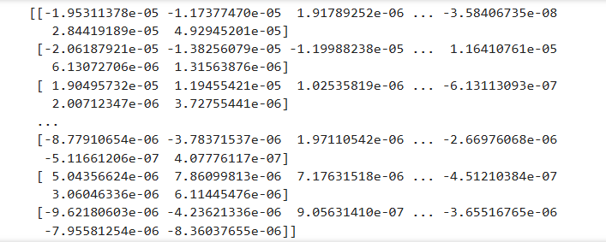
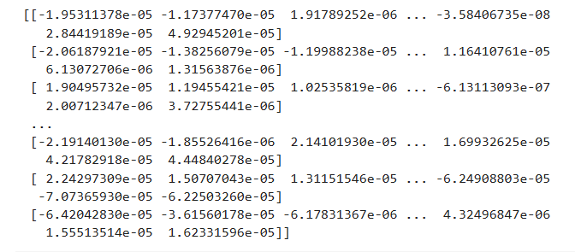
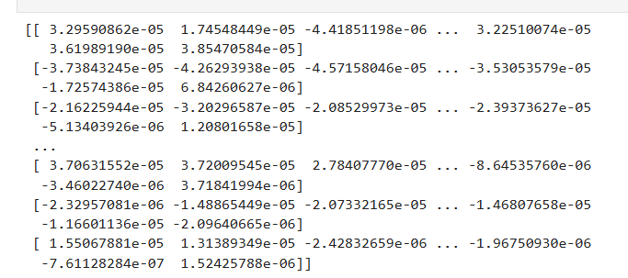
RESULTS

Slide 13
CONCLUSION
The proposed Brain Control Interface system uses EEG signals and an Artificial Neural Network (ANN) to classify brain activity and generate control commands. These commands are sent to an ESP32 microcontroller, which controls an LED based on the detected brain signals. The project demonstrates the potential of EEG-based Brain–Computer Interfaces for enabling direct communication between the human brain and external devices.

Slide 14
FUTURE SCOPE
1. Real-Time EEG Signal Acquisition
The system can be upgraded to work with live EEG headsets instead of pre-recorded datasets. This will enable real-time brain signal processing and make the Brain–Computer Interface more practical for everyday applications.
2. Integration with Robotic Arms and Assistive Devices
The classified EEG signals can be used to control robotic arms, wheelchairs, and other assistive devices. This can help individuals with physical disabilities perform tasks independently through brain-controlled commands.
3. Implementation of Advanced Deep Learning Models
Deep learning techniques such as Convolutional Neural Networks (CNNs) and Long Short-Term Memory (LSTM) networks can be employed to improve classification accuracy, enhance system reliability, and support more complex brain-controlled operations.

Slide 15
REFERENCES
Ramírez-Arias, Francisco Javier, et al. "Evaluation of machine learning algorithms for classification of EEG signals." Technologies 10.4 (2022): 79.
Ekinci, Ekin, Zeynep Garip, and Kasım Serbest. "Electromyography based hand movement classification and feature extraction using machine learning algorithms." Politeknik Dergisi 26.4 (2023): 1621-1633.
Al-jumaili, Saif, et al. "Investigation of epileptic seizure signatures classification in EEG using supervised machine learning algorithms." Traitement du Signal 40.1 (2023): 43.
Shi, Jianwei, et al. "EPAT: a user-friendly MATLAB toolbox for EEG/ERP data processing and analysis." Frontiers in Neuroinformatics 18 (2024): 1384250.
Yu, Hui, et al. "Technical system of electroencephalography-based brain–computer interface: Advances, applications, and challenges." Neural Regeneration Research 21.9 (2026): 3885-3907.

Slide 16
THANK YOU

